Slide 1
SEMINAR III Towards Detecting Dictionary Based Malicious Domain Names
Mr. Amir Mukeri
M.E. (Computer Engineering) Candidate
Roll No. 18MC001
Department of Computer Engineering
mukeriamir@gmail.com
Under the guidance of:
Dr. D.P. Gaikwad
Department of Computer Engineering

Slide 2
Malware Communication
Host infected by malware communicates with attacker’s Command & Control (C&C)
Communication is for
Data exfiltration
Downloading encryption keys for ransomware attacks
Instructions for further download and spread of malware

Slide 3
Algorithmically Generated Domain (AGD)
Domain name for C&C are nowadays generated algorithmically, Algorithmically Generated Domain (AGD) domain names.
Random gibberish: ocufxskoiegqvv.com
More sophisticated Domain Generation Algorithm(DGA) such as matsnu and suppobox are relying on valid dictionary based domain names: scoreadmireluckapplyfitcouple.com
Dictionary wordlist based domain names are difficult to detect and block.

Slide 4
Related Work
Kührer et al. evaluated the public and vendor provided blacklist based approach to blocking malicious domain names. They found that these blacklist contained only 20% of major domains from malware families and failed to provide any protection against AGD names.
Antonakakis et al. suggested clustering and classification based approach to process the domain names in respective DGA families.
Bahnsen et al. found RNNs to be more superior in performance compared to random forest based models.
Woodbridge et al. used Long Short Term Memory (LSTM) architecture to detect the AGD names. Their proposed method improved accuracy of detection however faced challenges when it comes to dictionary or wordlist based DGA.
A hybrid neural network approach comprising of parallel CNN and attention based Bi-LSTM layers was designed by Yang et al.
Fangali et al. used CNN, Bi-LSTM and Attention layer after the embedding layer to do the detection as well as multiclass classification of various DGAs

Slide 5
Gap Analysis
Machine Learning based approaches involve feature selection and engineering and found to be inadequate in detecting malicious domain names.
Most of the current state of the art faces challenge in detecting and classifying dictionary based domain names.

Slide 6
Proposed Work
Analysis of effectiveness of various deep learning models in detecting and classifying malicious domain names (both random and dictionary based).
Design of AGD detector and classifier based on transfer learning in Transformer architecture.

Slide 7
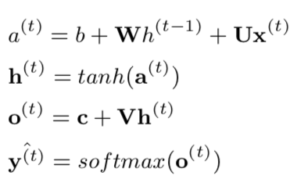
Recurrent Neural Network(RNN)
Handles variable sequence inputs
Recurrent loop from output to inputs to handle variable length data
Weights are shared across layers
Backpropagation Through Time (BPTT)
U,V,W are weight matrices, b and c are biases, h is a hidden state. Hidden state at a time t is an input to next time step t+1. Final layer is a softmax layer that gives a valid probability distribution over output sequence.

Slide 8
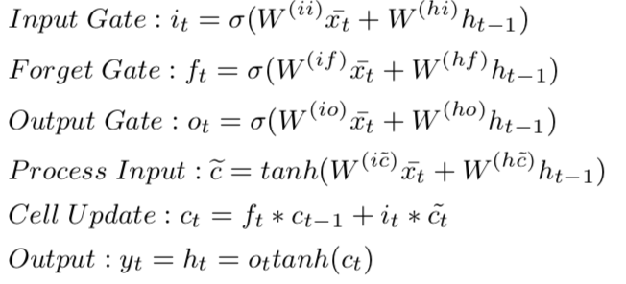
Long Short Term Memory(LSTM)
Special gated structure with three gates to control memorization and forgetting in RNN.
Mitigate the problem of vanishing gradients and also allows for remembering over long range.
Bi-LSTM: two LSTM layers, one processes words in a sentence in forward and another in backward direction since many times context in one direction is not sufficient for prediction or in language modeling tasks.
Notes:
Input Gate > Controls Input
Forget Gate > Controls Hidden state
Output Gate > Controls Output
Changes from RNN include, hidden state ht becomes cell state ct and output yt becomes hidden state ht

Slide 9
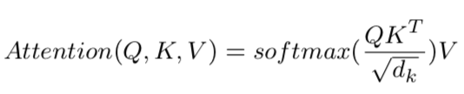
Transformers
Attention Mechanism: Helps in focusing for more relevant words in sentence while deciding how much importance to give to which part.
Attention is basically a scaled dot product that assigns probability distribution over keys that are closely aligned to query vector Q
Transformer remove the recurrent layers thereby reducing the training time and making it possible to take advantage of parallel operations which was not possible with RNN due to sequential series of operations.
Notes:
Transformer architecture consists of encoder and decoder. Consider an example of machine translation task.
Source language statement is embedded and processed by encoder while the target language translation so far is produced by decoder one token at a time.
Implementation of Transformer architecture was found to outperform all the state of the art machine translation benchmark and soon became the state 0f the art mode for machine translation and other NLP tasks.

Slide 10
Bidirectional Encoder Representations from Transformer(BERT)
Bidirectional Encoder Representations from Transformer (BERT) by Devlin et al. in 2018 that takes benefit of transfer learning.
Transfer learning allows model trained on different dataset to be utilized for specific downstream task.
BERT is based on Transformer architecture however it only uses encoder from Transformer.

Slide 11
Training BERT
Training BERT happens in two steps viz. Pre-training and Fine-Tuning.
In pre-training phase, through unsupervised learning BERT develops natural language understanding using Masked Language Modeling(MLM) and Next Sentence Prediction (NSP).
MLM: unsupervised task where a random word is masked in a sentence and model predicts the probability distribution of output words.
For language modeling BERT uses deep bidirectional model instead of using only left-to-right or concatenated two model outputs.
NSP: given a pair of sentences A and B, if B follows A then its labelled as IsNext otherwise NotNext.
In fine-tuning phase, BERT is trained for task specific labeled dataset such as sentiment classification or Question-Answering. In this phase, pre-trained model is trained end-to-end and all the parameters are fine tuned for specific task. This is relatively inexpensive and less time consuming training.
BERT is pertained on Wikipedia and BookCorpus dataset.
BERTbase model with total of 110M parameters.

Slide 12
Dataset
Real world domain names generated using domain generation algorithms were used for experimental analysis from UMU DGA dataset.
Dataset consisted of 110,000 legitimate domain names and approximately 10000 domain names generated using various DGAs.
Dataset was split into training and test dataset with a proportion of 70%:30% of randomly chosen samples.
Pre-processing:
Entire dataset was encoded using character level encoding.
Output labels belonging to 19 different DGAs were represented using one hot encoding.
Pre-padding was done in case domain names were smaller than maximum domain length.

Slide 13
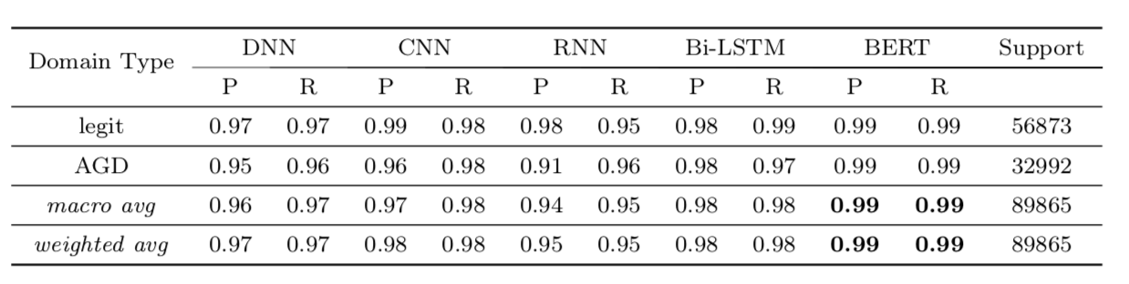
Results DGA Detection
Proposed BERT model provides more than 9 point absolute improvement over recent results reported by Yang et al. and by Fangali et al.

Slide 14
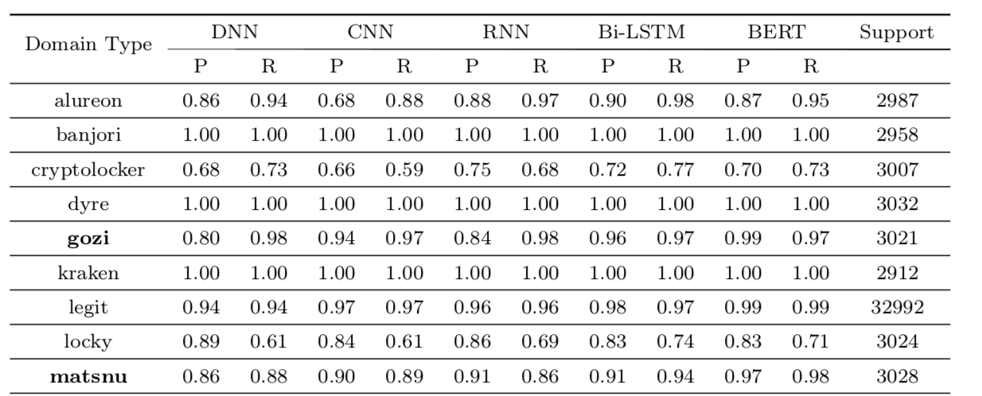
Results DGA Classification
Classification efficacy of BERT model is highest for dictionary based such as gozi, matsnu, and suppobox.
BERT based classifier outperforms other recent results for both dictionary based and random DGAs.

Slide 15
Conclusion
Use of algorithmically generated and dictionary based domain names pose a challenge for security experts and network administrators.
Current state of the art methods for this task are inadequate for handling this challenge.
The proposed model makes use of stacked bi-directional encoder from Transformer architecture.
This method is effective and doesn't require any hand crafted features.
Experiments on real word domain names dataset indicates that this model delivers F1 score of 0.99 and more than 0.98 for detection and classification tasks respectively.
Proposed mechanism is effective against both random and dictionary based domain generation algorithms.

